Slide 1

BCSC1002 – Object Oriented Programming Course Introduction

Slide 2
Introduction
Welcome, to BCSC1002 – Object Oriented Programming, here we are going to discuss importance of Object Oriented Programming.

Slide 3
Introduction
Object Oriented Programming is a Paradigm (.. A style of programming, as of now you are aware about procedural style in C programming )

Slide 4
Introduction
Object Oriented Programming helps you to develop software's with clean code.
Go and check Spaghetti_code on wiki

Slide 5
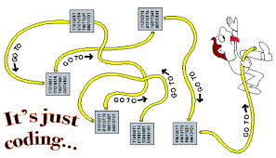
Introduction
Spaghetti code

Slide 6

Introduction
Software Industries Looking for
Developer’s who understand and develop software’s using Object Oriented Paradigm.

Slide 7


Introduction
This course will guide you in building robust applications by using Object Oriented Approach.
You can build "Mobile Application" as well as "Enterprise Applications" using Object Oriented Paradigm and your code will be able to adjust with client's changing requirement.

Slide 8


Introduction
This course will be helpful in
Mini-Project 1,
Mini-Project 2 and
Major Project.

Slide 9

Introduction
This course also let you prepare for all the Technical Interview during campus drives, as most of the companies will ask Object Oriented concept and implementation.

Slide 10
Introduction
In this course:
we had also included the version controlling through Git,
Developing better code together through GitHub,
faster development through Intellij Idea (Integrated Development Environment) and
managing all these through google classroom.

Slide 11
Thank You

